Slide 1
Good Evening,
I'm Mridul Tiwari, and I'm eager to share some information with you regarding your company. I appreciate you giving me the leading questions. I really believe you will find the analysis convincing and useful as you decide how to proceed with your next business prospects.
I want to start by assuring you that I have given the most accurate and current analysis. I cleaned up any records with negative quantities and unit prices after loading the data into my software, since it was necessary to do so in order to give useful analysis.

Slide 2
For 1st Question
Regarding your first query, the CEO has asked for a revenue trend to determine whether retail sales are seasonal. According to the data, there are several months of the year that have significant development. According to the statistics, the first eight months of sales from January to August were very stable, with an average of $685K (Six hundred eighty-five thousand US dollars) in revenue per month. The increase in revenue begins in September, when it grows by 40% over the previous month. This pattern persisted up until November, when it rose to 1.5 million US dollars, the largest amount of the whole year. Unfortunately, since the data for December is insufficient, no inferences can be made from it. This research demonstrates how seasonality—which generally happens in the last four months of the year—affects retail store sales.

Slide 3
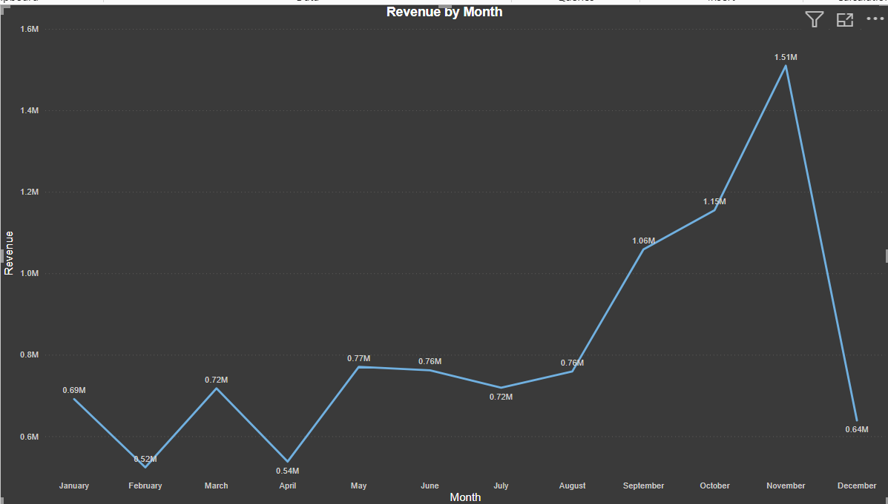

Slide 4
For 2nd Question
The top 10 countries with the most potential for growth are represented in the second graph. Since the UK already has a large demand and I understand you are more interested in nations where demand may be boosted, the UK is not included in these statistics. According to the data, sales of units and income are quite high in nations like the Netherlands, Ireland, Germany, and France. To guarantee that steps are taken to further seize these markets, I would propose concentrating on these nations.

Slide 5
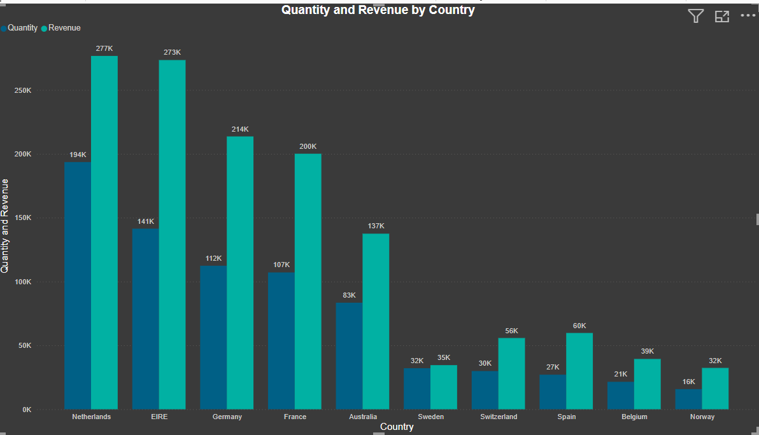

Slide 6
For 3rd Question
The top 10 consumers who have made the most purchases from the business have been the subject of the third study. According to the statistics, there are not many differences between the top 10 consumer purchases. The fact that the highest revenue-producing consumer only spent 17% more than the second highest demonstrates that the company does not rely solely on a small number of consumers to generate income. This demonstrates that consumers' ability to negotiate is limited and that the state of business is positive.

Slide 7
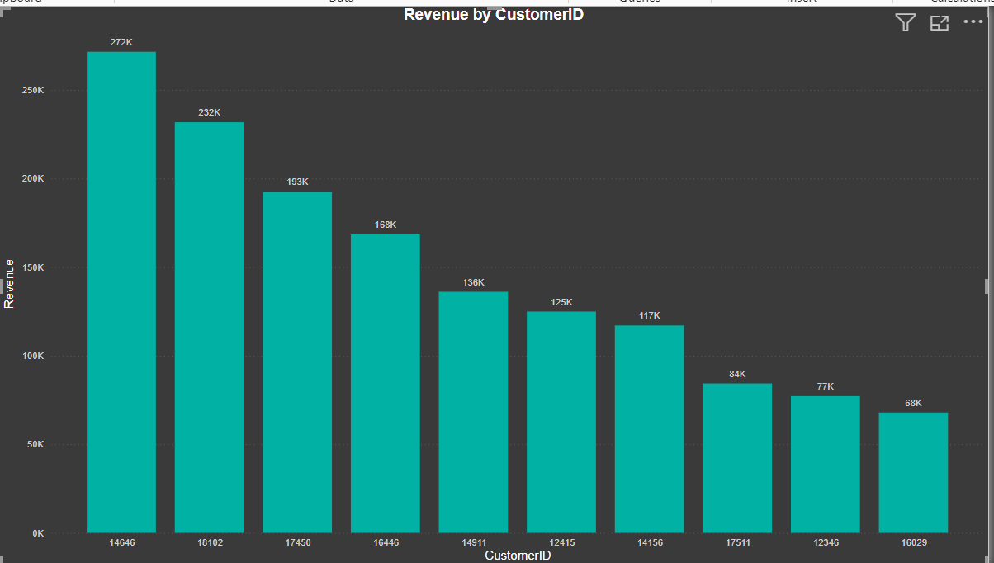

Slide 8
4th Question
The map chart concludes by comparing the places that have produced the greatest revenue to those that have not. Apart from the UK, it is clear that nations like the Netherlands, Ireland, Germany, France, and Australia generate large profits, and the company should invest more in these nations to boost product demand. The map also reveals that the majority of sales occur only in the European zone, with only a small number in the American region. Along with Russia, there is no market for the items in Africa or Asia. Sales revenues and profitability might increase with the implementation of a fresh strategy focused on these areas.

Slide 9
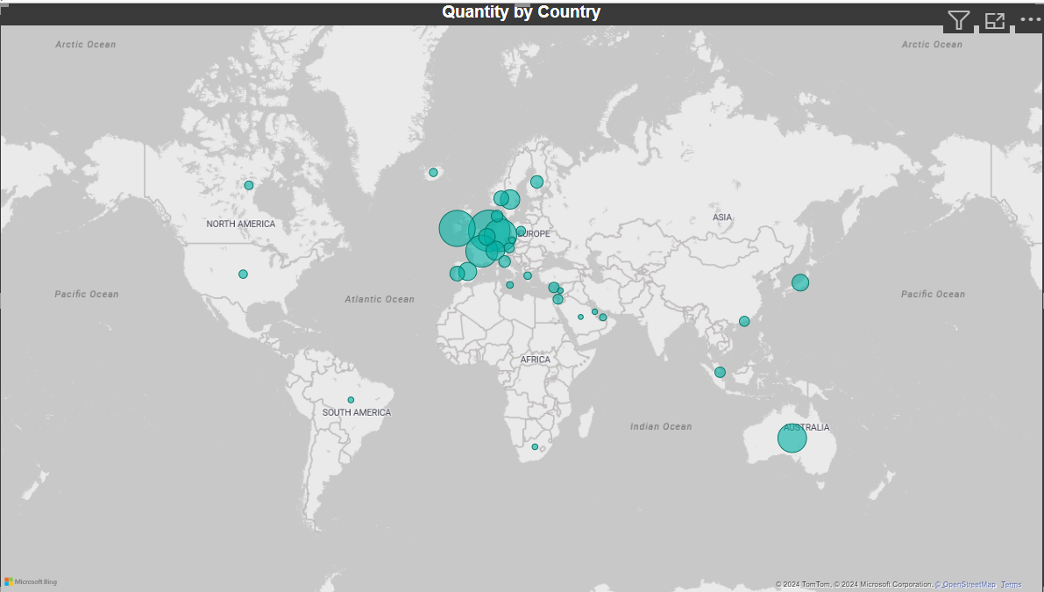

Slide 10
After you've had a chance to process this material, if you have any questions about the analysis or would want to see anything additional, I would be glad to create it for you.
Thank You

